Slide 1

Measles Elimination Strategies
Goal: Measles elimination in Kenya by 2030
Defined as the absence of endemic measles virus transmission for ≥12 months in the presence of a high-quality surveillance system
1

Slide 2
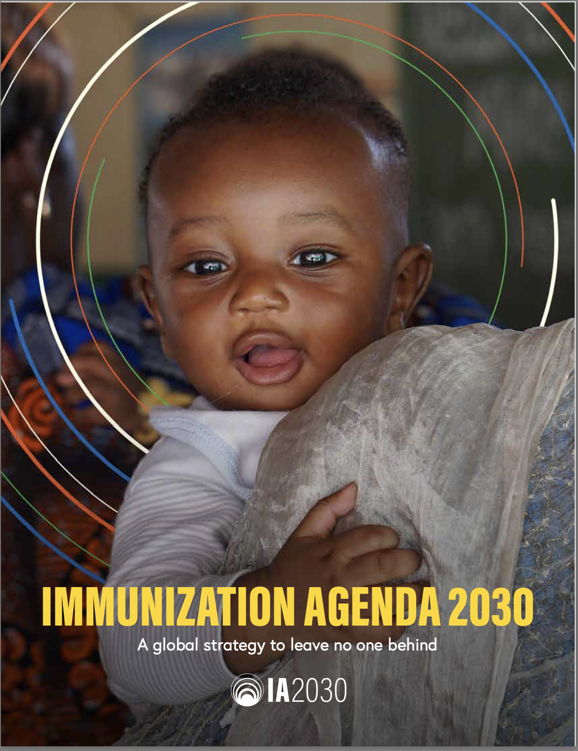
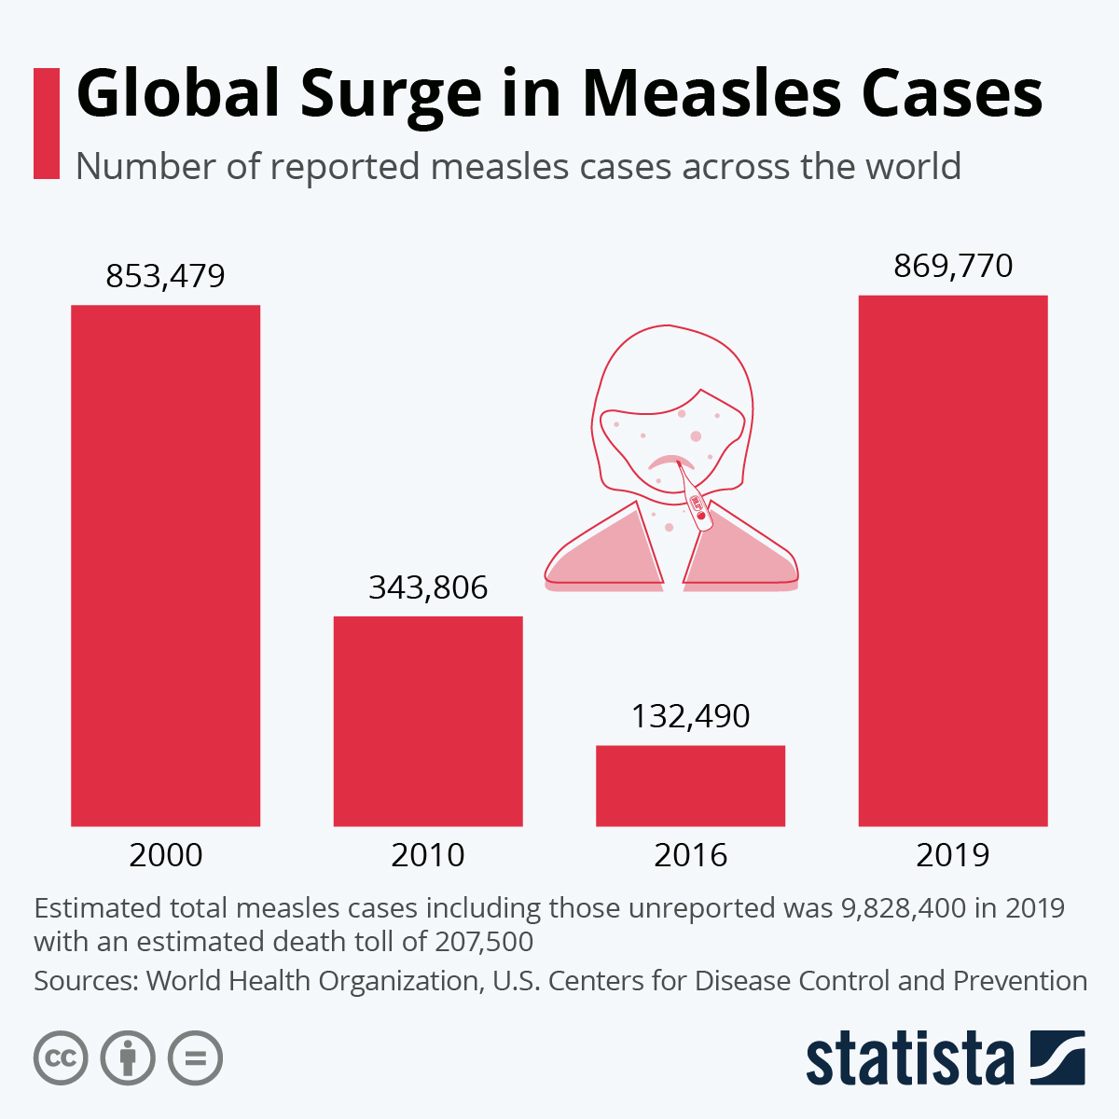
Eliminate measles in at least five WHO regions by 2020
Achieve measles elimination in 80% of countries in AFRICA by 2030
95% MCV1 and 2 coverage with SIAs to maintain population immunity at 95%
2

Slide 3
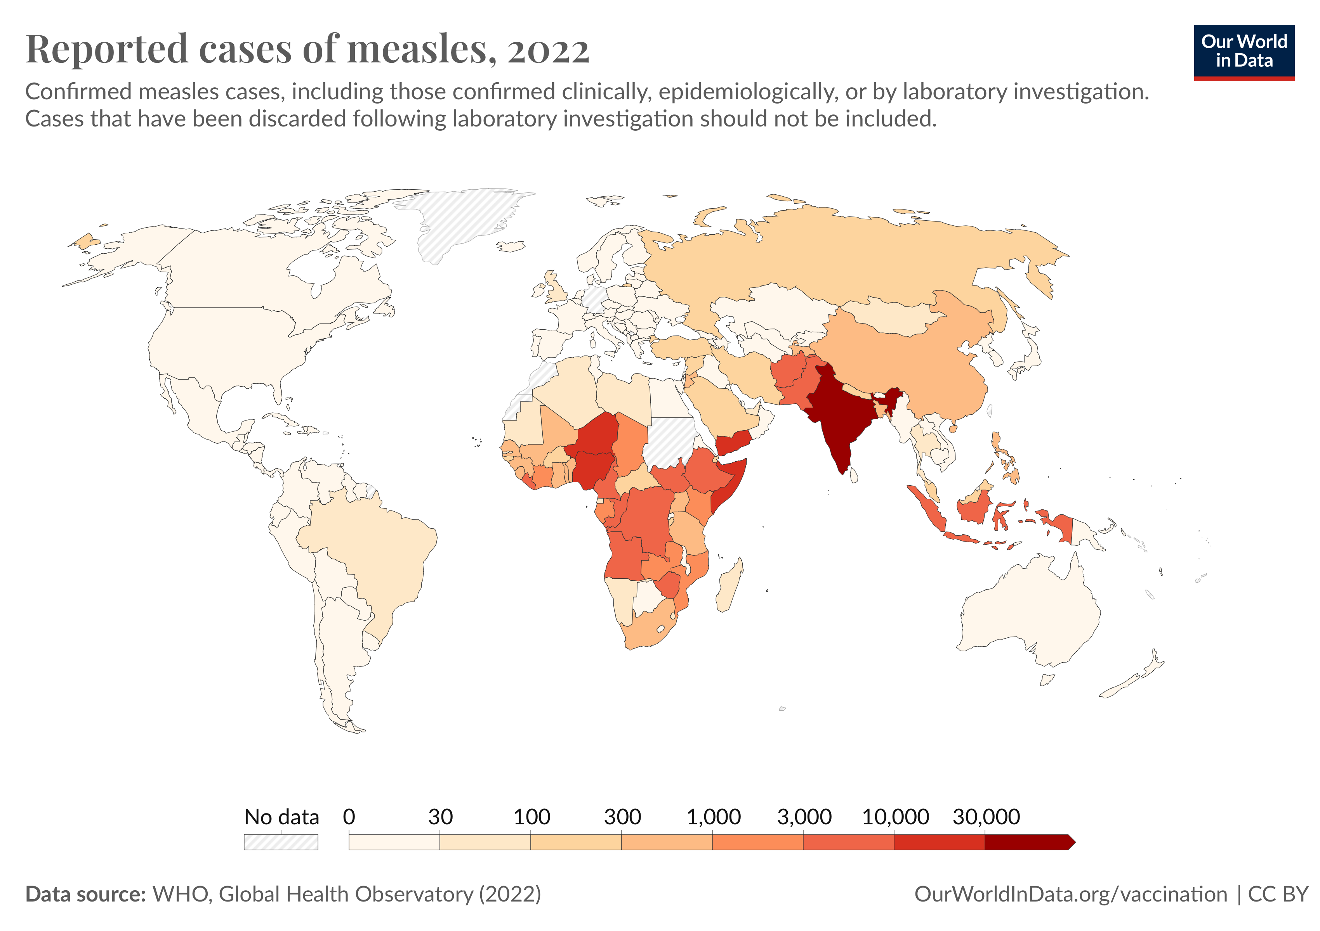
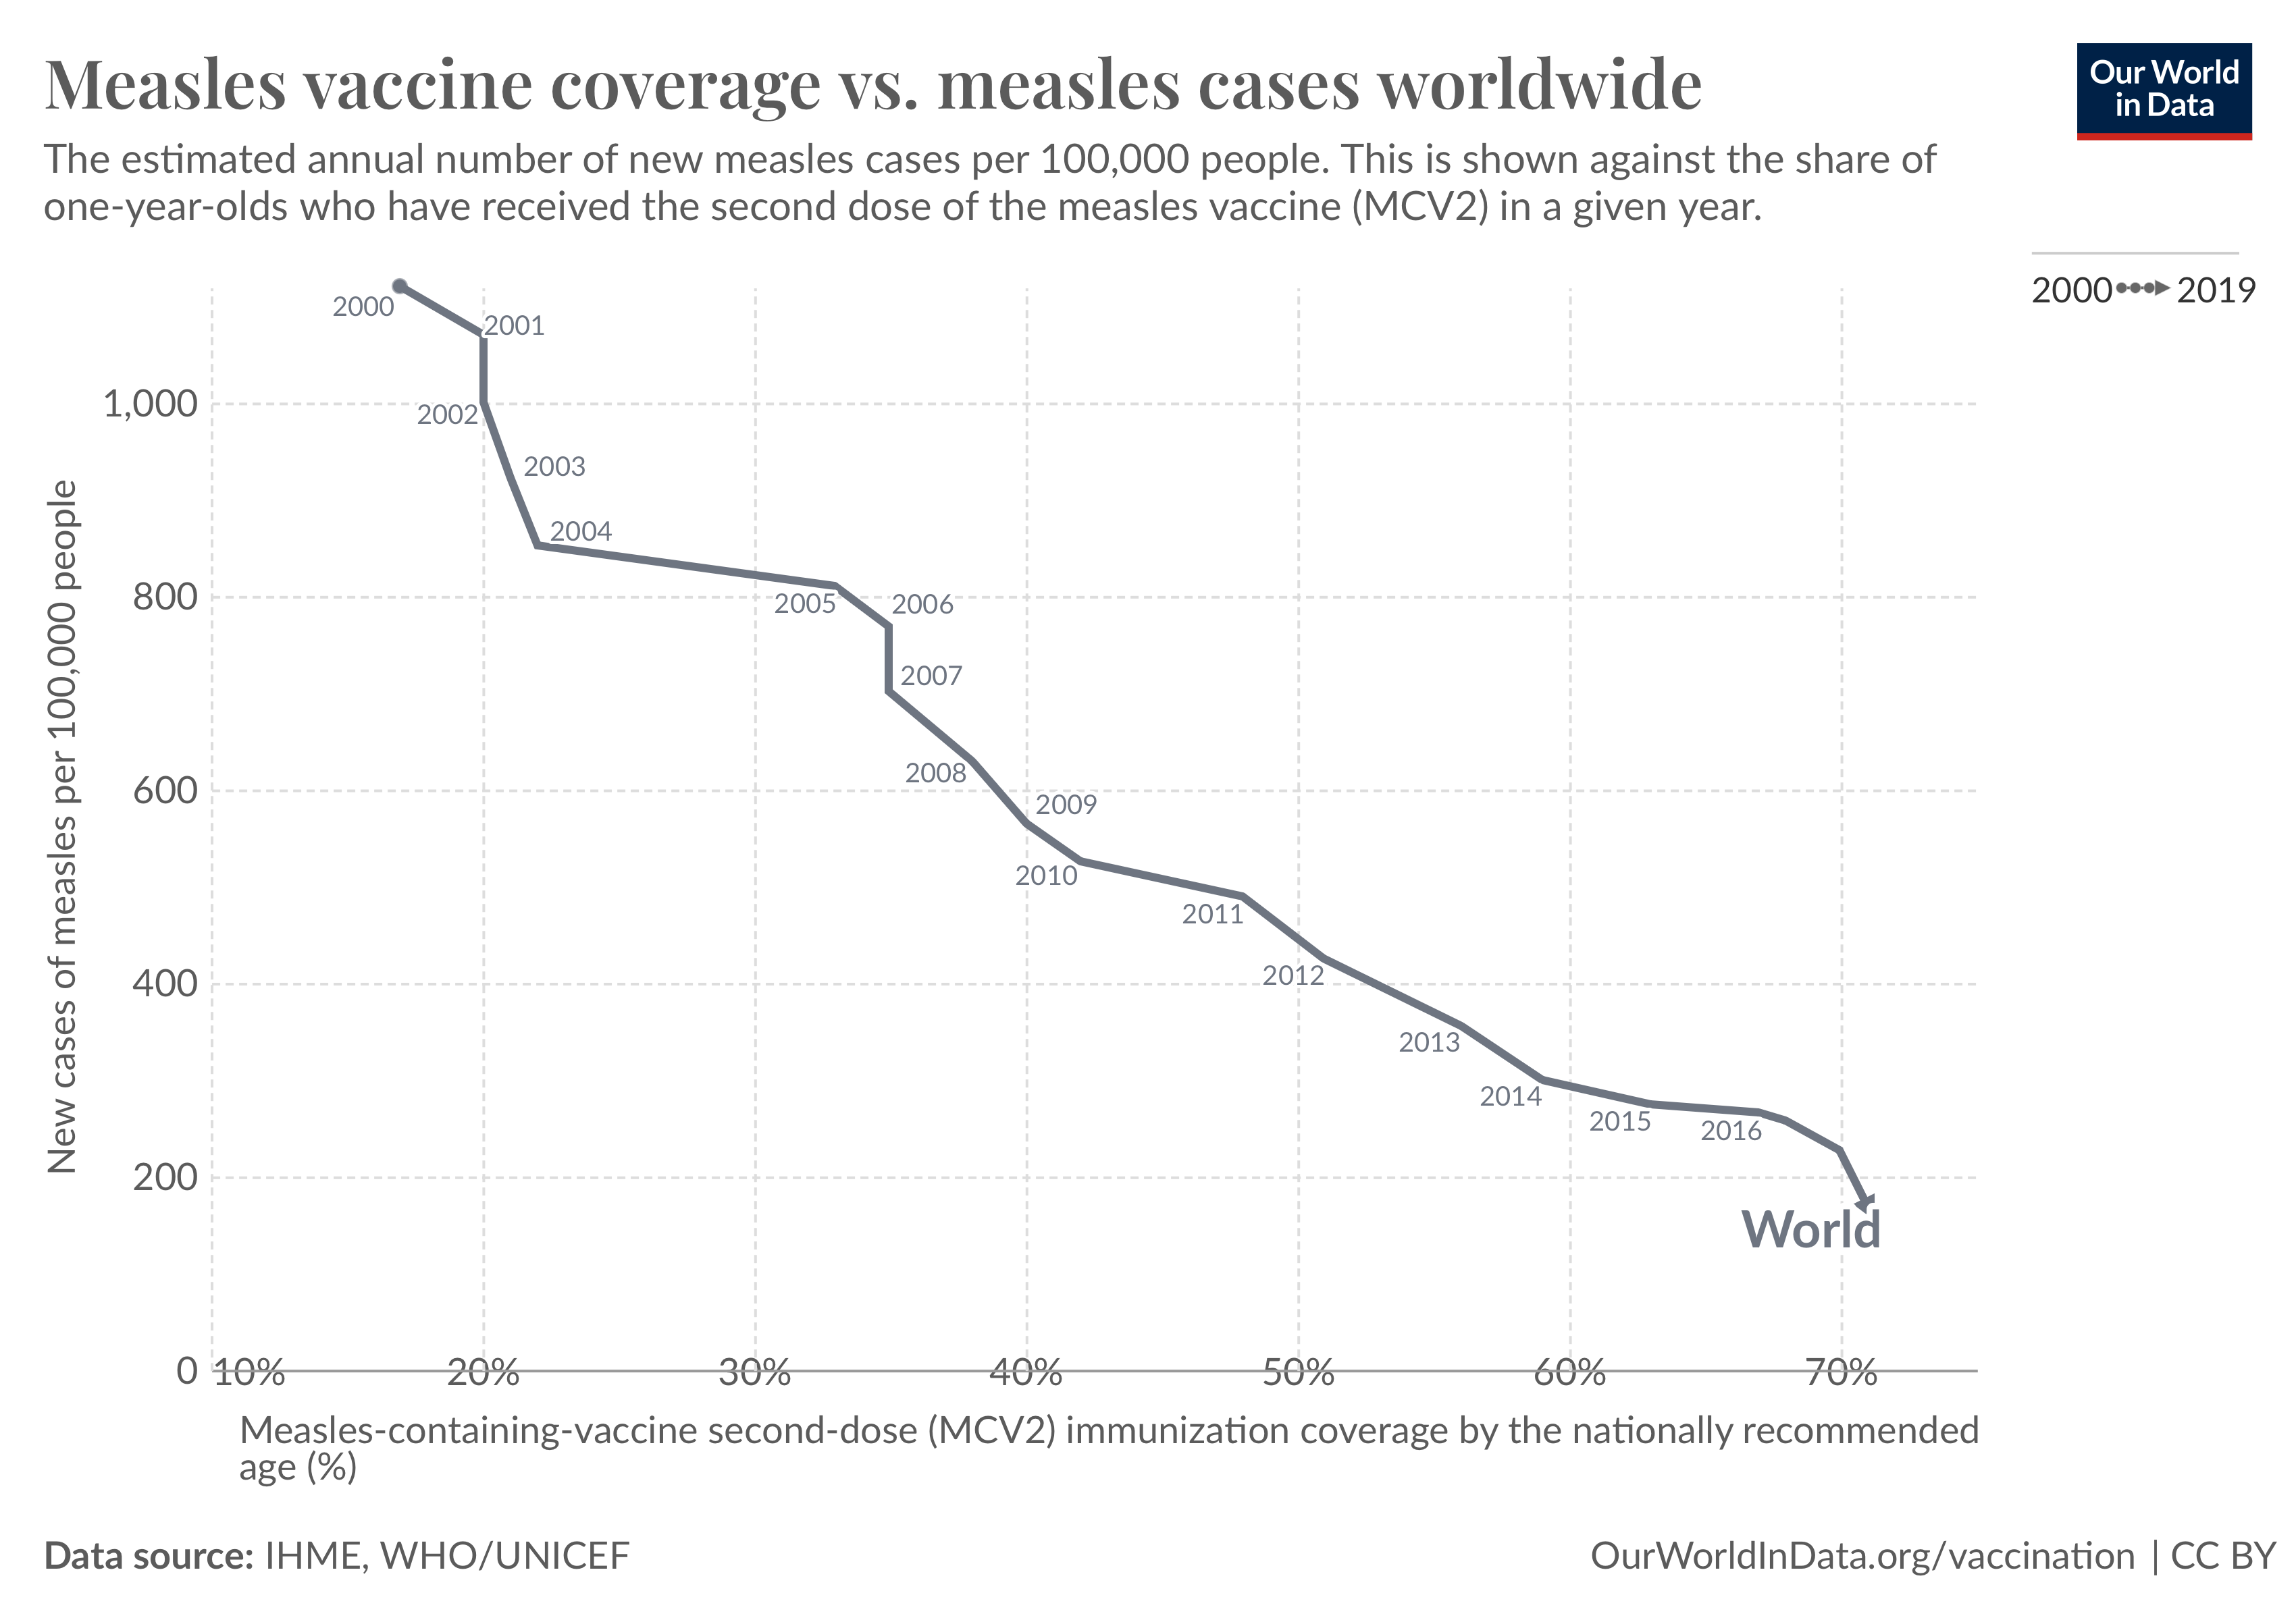
Research gap
Measles transmission continues despite improvements in measles vaccination
Most countries failed to meet 2020 targets
Kenya reports up to 3000 cases each year
3
Notes:
How then, can we better arrange our interventions so that we achieve our goal and what is stopping us from doing so

Slide 4
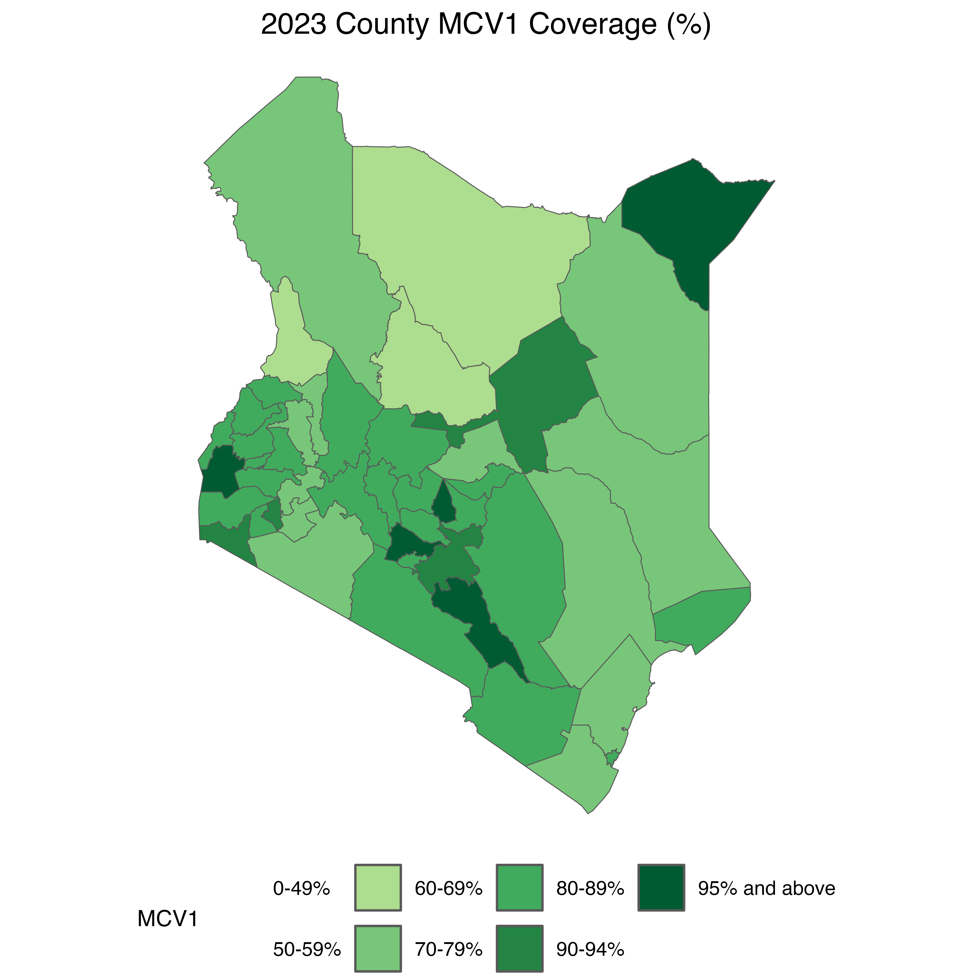
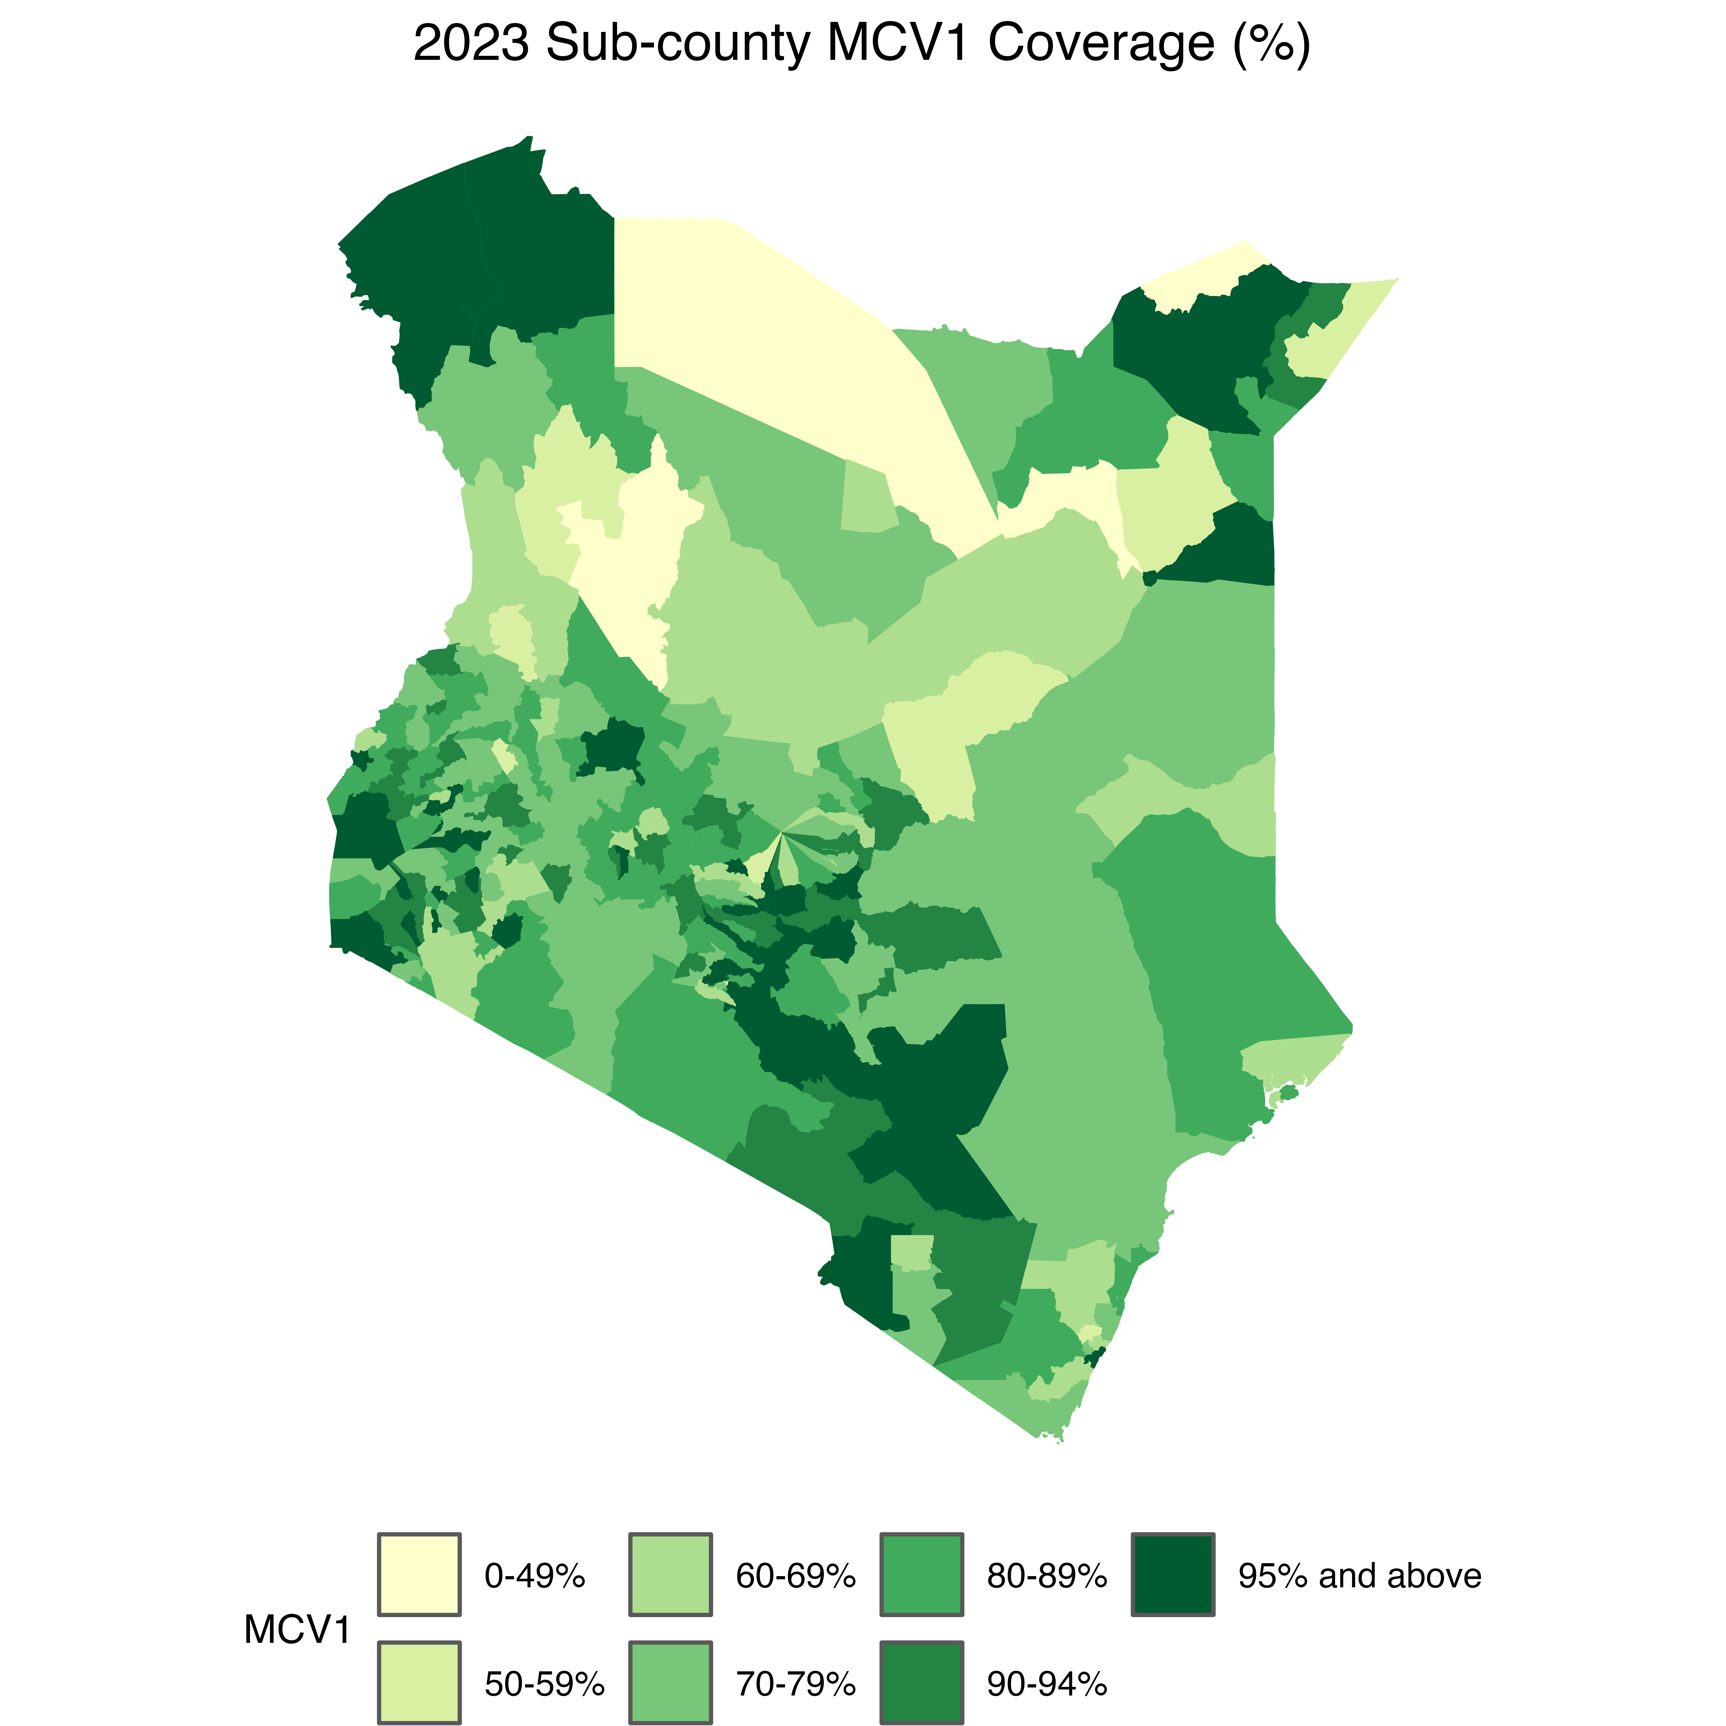
MCV 1 coverage Kenya in 2023 (83%)
Sub county estimates
County estimates
4
Notes:
Focus on sub national variability

Slide 5
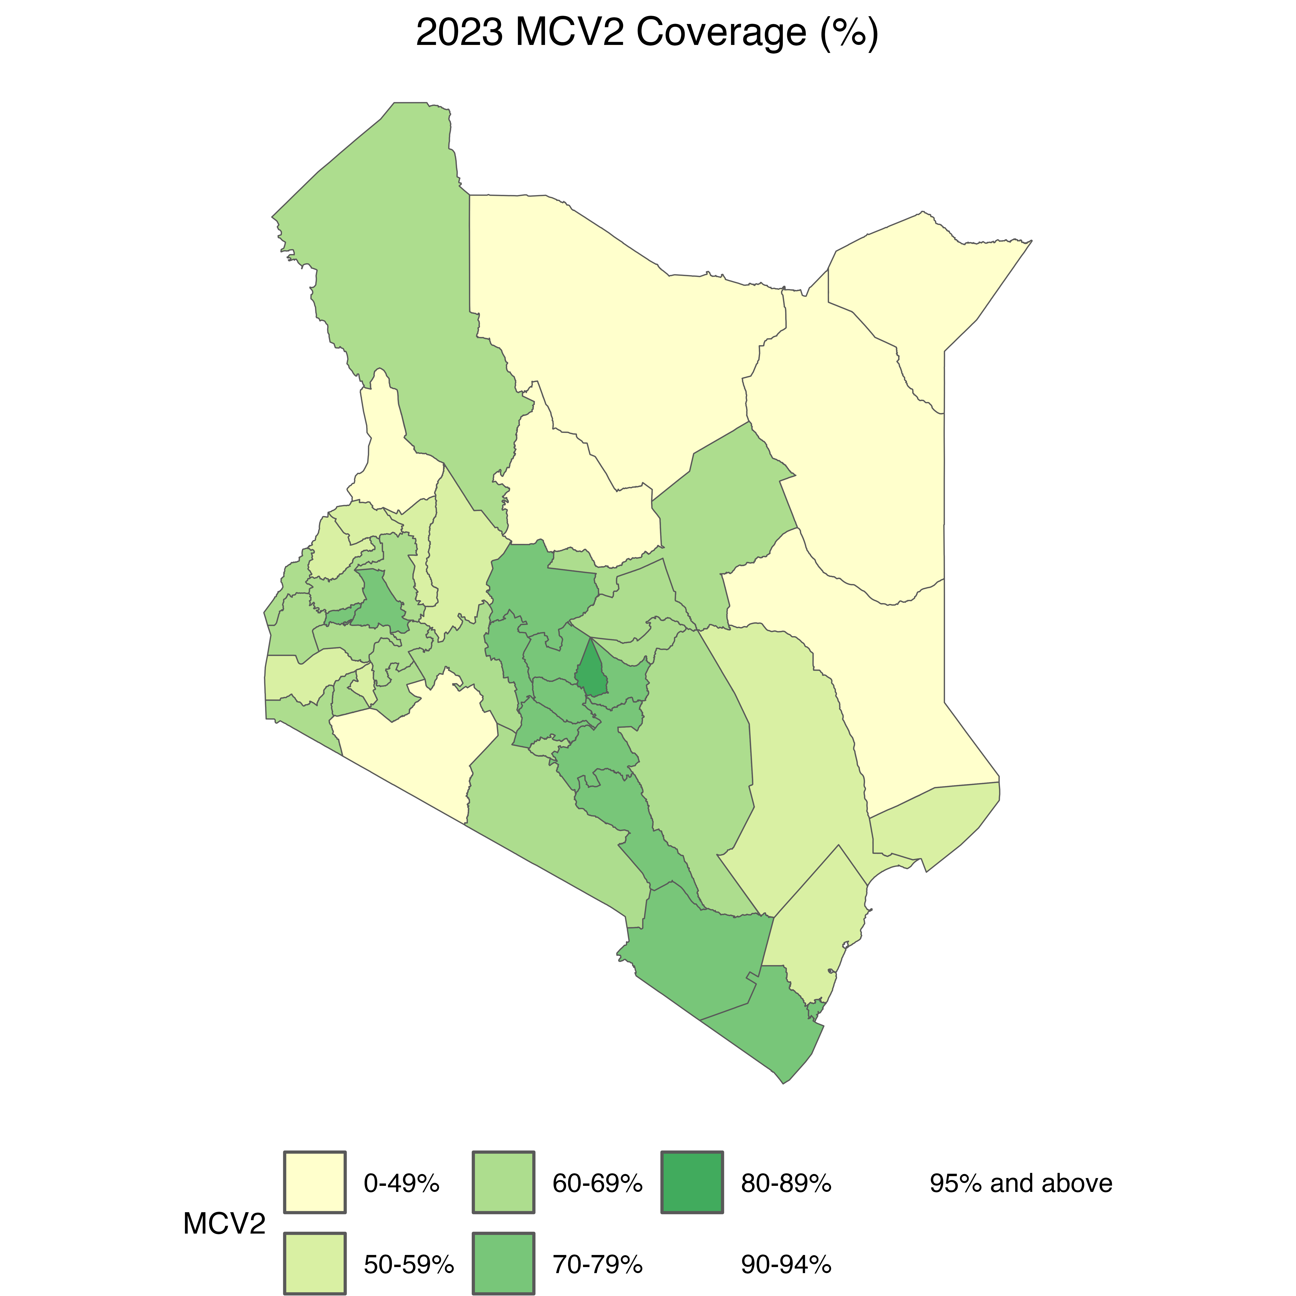
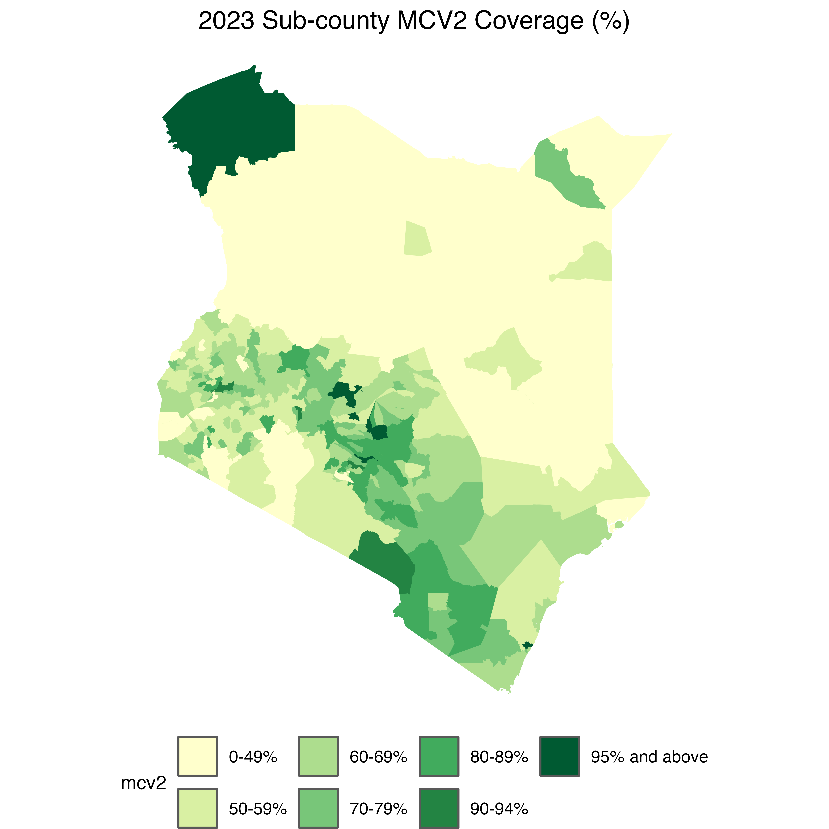
MCV 2 coverage Kenya in 2023 (62%)
Sub county estimates
County estimates
5

Slide 6
WHO recommended vaccination coverage
MCV1
MCV2
6

Slide 7
MCV coverage and measles infections in Kenya Jan ‘20 – Dec ‘23
MCV1
MCV 2
Measles
cases

Slide 8
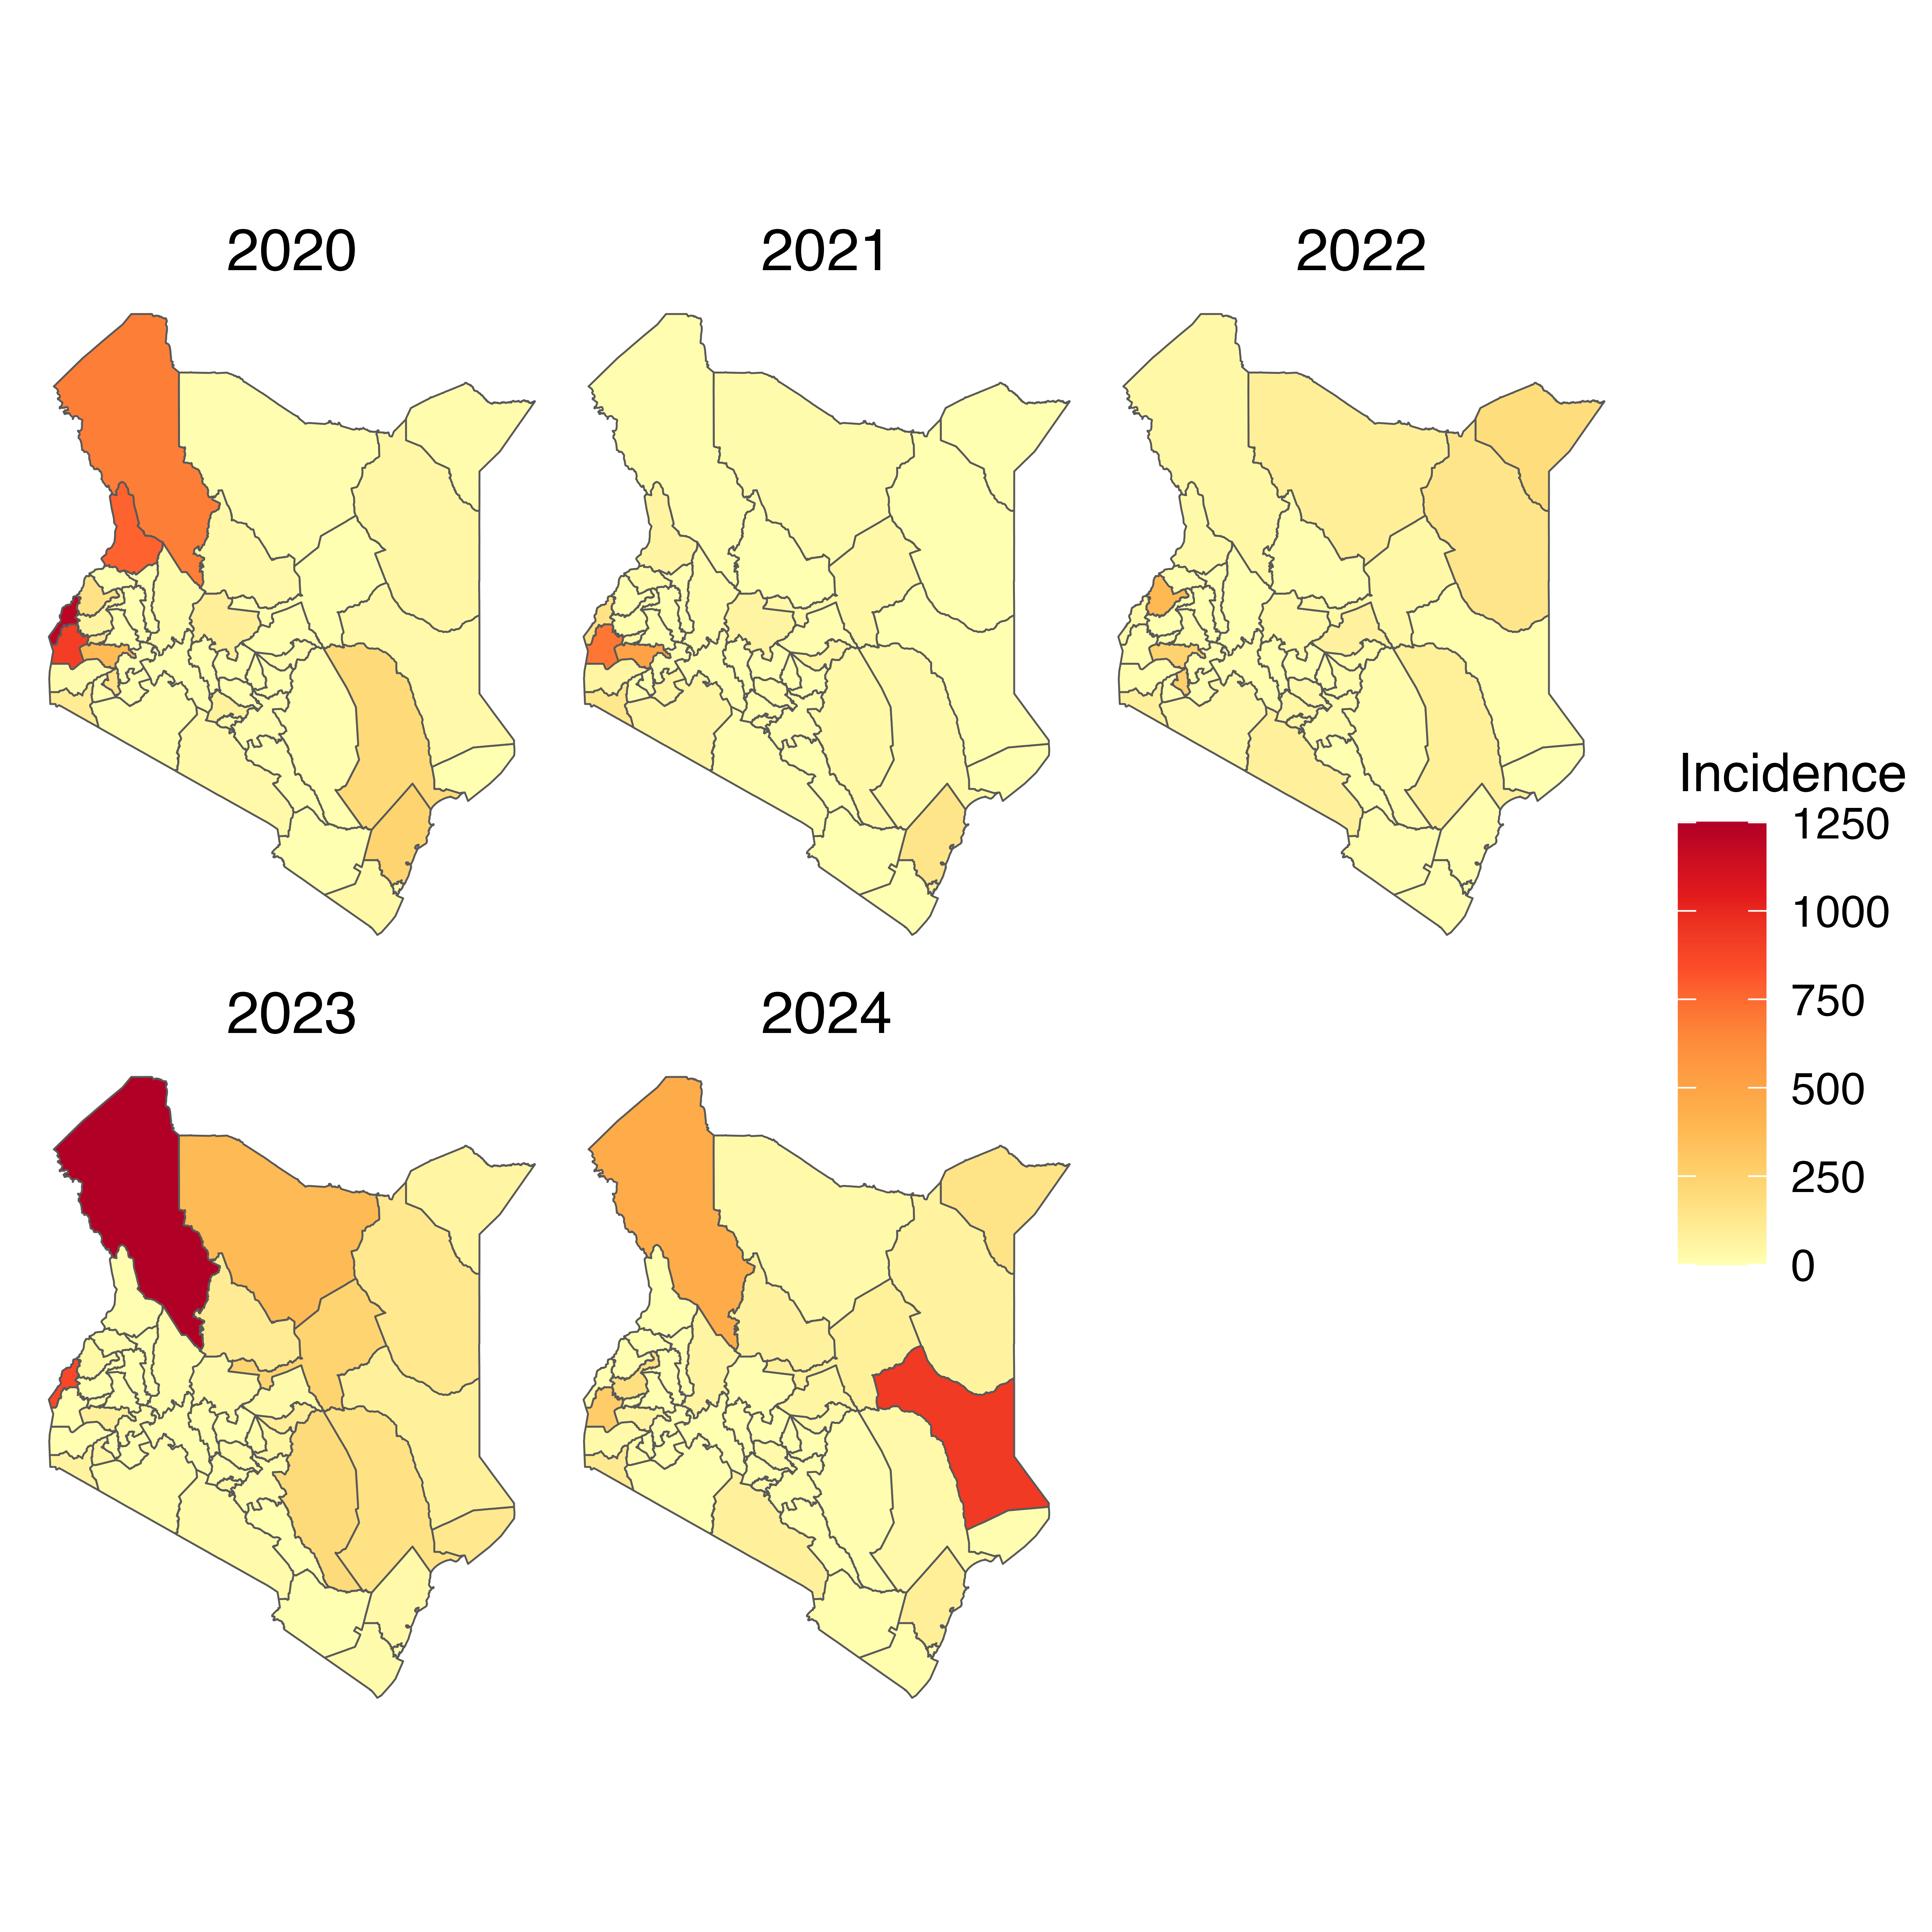
County measles incidence
Turkana county has had periodic measles incidence
Most counties had <250 measles incidence.
Turkana
Garissa
8

Slide 9
Research question
How frequently should supplementary measles campaigns be conducted in Kenya given varying measles vaccine coverage at the sub national level in order to achieve measles elimination before 2030?
Supplementary
Immunization
Activity
(SIA)
9

Slide 10
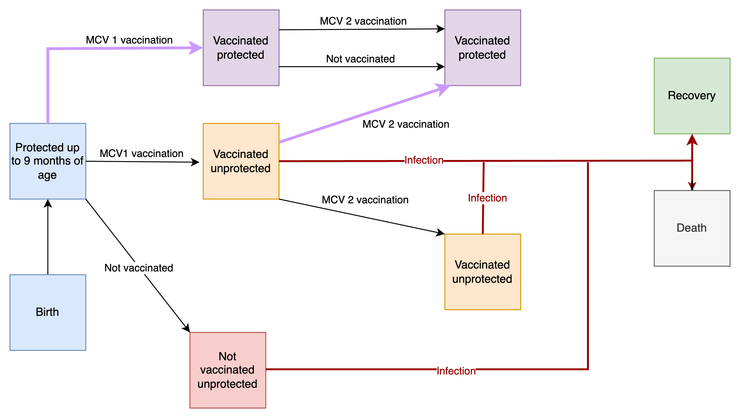
Agent based model Starsim (SEIR)
Setting: Kenya – Counties
Time horizon: 2020 - 2040
Parameters
Transmissibility: 0.9
CFR: 5%²
Contacts: 4 per
Birth rate: 27 per 1000¹
Death rate: 8 per 1000¹
MCV 1 effectiveness: 85%²
MCV 2 effectiveness: 95%²
Intervention:
SIA (measles campaign)
Outcome: no. of infections
Figure: ABM flow chart
NB: Additional measles doses beyond MCV1 are to protect children who did not develop protective immunity after the 1st dose.
SIAs can reach up to 85% of previously unvaccinated and vaccinated children.
10
1. Macrotrends; 2. WHO

Slide 11
Results: MCV coverage that will achieve 2030 elimination strategy
Measles vaccine dose 1 coverage | Measles vaccine dose 2 coverage | Number of years
95% | 0% | 4
95% | 10% | 4
95% | 20% | 4
95% | 30% | 4
95% | 40% | 4
95% | 50% | 3
95% | 60% | 3
95% | 70% | 3
95% | 80% | 3
95% | 95% | 3
Makueni County
Scenario: An area with a low incidence of measles (1case per a million)
Maintenance of MCV1 at >95% for 4 years prior to 2020
Maintenance of the 95% coverage of MCV1 would reach the county to elimination within the 2030 target
11

Slide 12
Results: MCV coverage that will achieve 2030 elimination strategy
Measles vaccine dose 1 coverage | Measles vaccine dose 2 coverage | Number of years
95% | 0% | >20
95% | 10% | >20
95% | 20% | >20
95% | 30% | >20
95% | 40% | >20 (2045)
95% | 50% | 10
95% | 60% | 10
95% | 70% | 10
95% | 80% | 10
95% | 95% | 10
Kisumu County
Scenario: An area with a moderate incidence of measles (300 cases per a million)
Maintenance of MCV1 at >80% but less than 95% for 4 years prior to 2020 and MCV2 at 80%

Slide 13

Putting our heads together

Slide 14
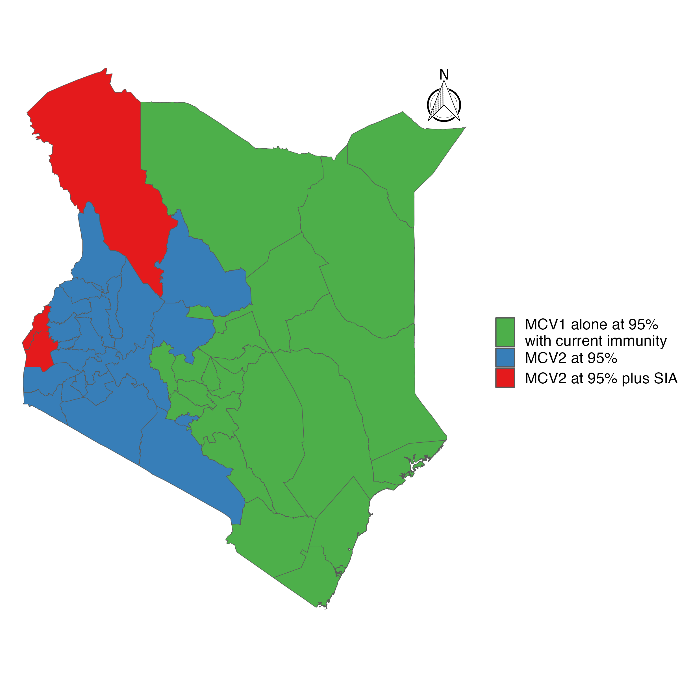
Interventions required to meet 2030 elimination targets
14

Slide 15
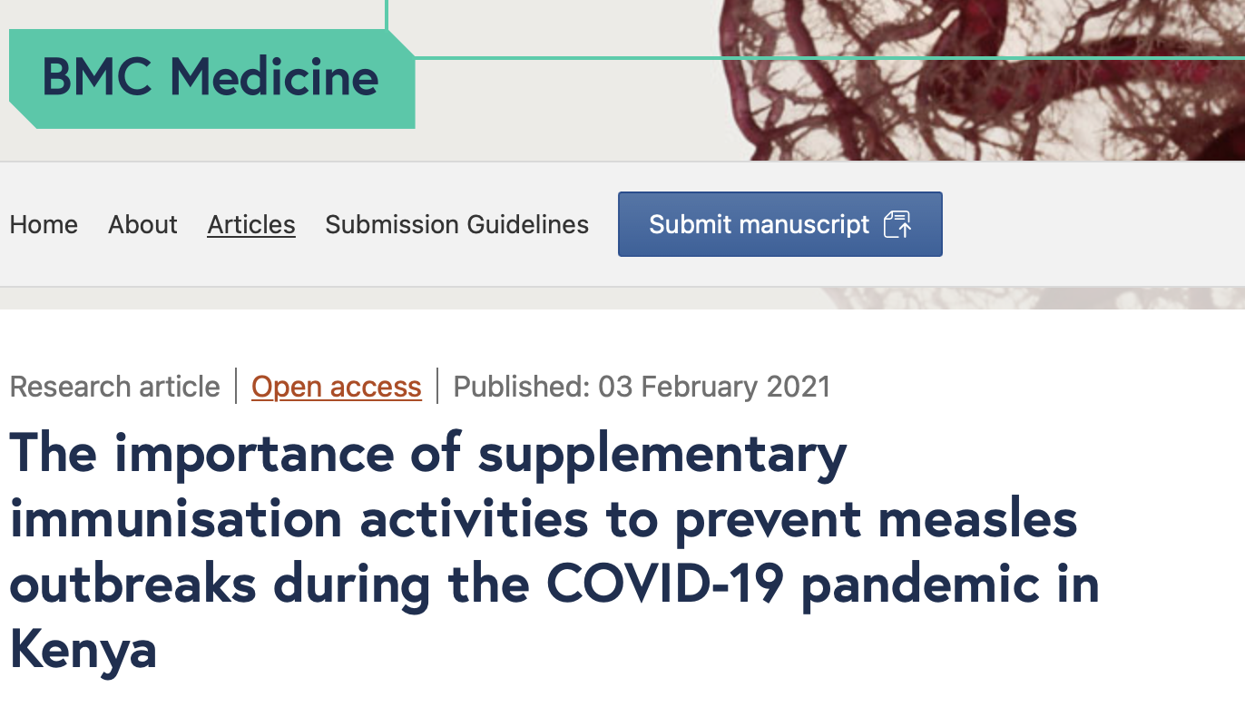
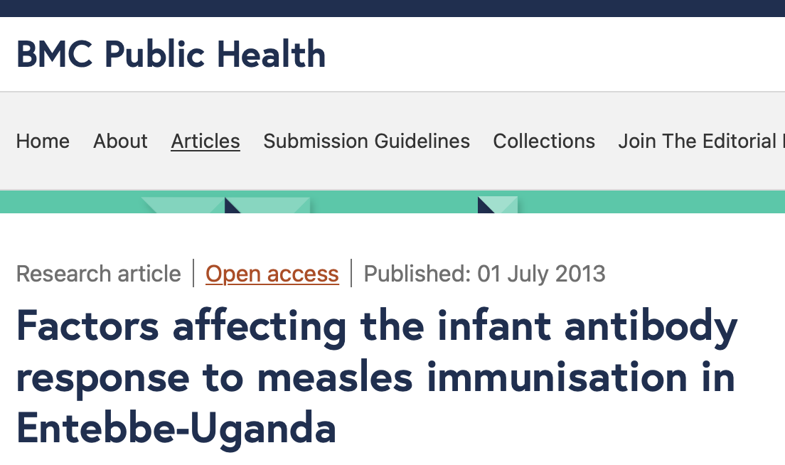
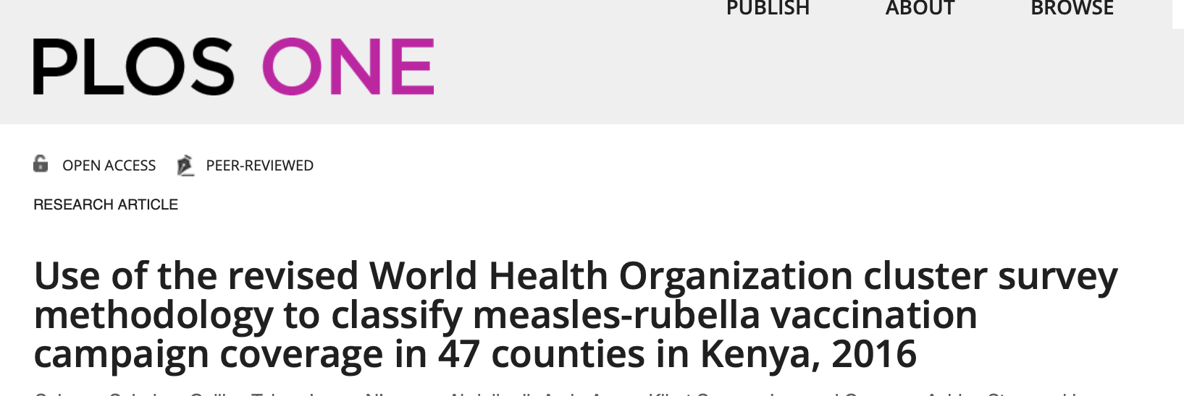
Uncertainty and Limitations
Assumptions – random contact rates, vaccine effectiveness, campaign coverage (reaching the unvaccinated child), perfect surveillance system
Incorporating uncertainty/stochasticity for incidence of measles cases (cross sub count/border movements)
Incorporating uncertainty around results
HIV, wasting

Slide 16
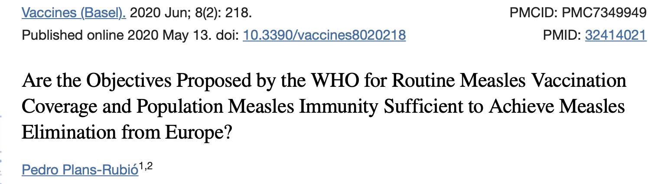
Conclusion
Differences in measles incidence and MCV coverage between sub national units
A uniform strategy to eliminate measles in Kenya is not appropriate – wastage of resources
Precision in administering interventions could help us reach our 2030 targets
AT WHAT COST?
ECONOMIC EVALUATION
16
Notes:
Why 95% if, we achieved 97% would we achieve more sooner, and without the cost of SIAs

Slide 17
Next steps
Model improvement
Outputs
Inclusion of age categories & Kenya contact patterns into model structure
Incorporation of effects of HIV and wasting on developing immunity
Fit model to Kenya data
Test different SIA scenarios at a sub national level (sub county)
Sub county analysis
Optimal number and frequency of SIAs to reach elimination goal (at the sub county level)
Cost effectiveness analysis of SIA – what is the cost of reaching 1 unvaccinated child through SIA
17

Slide 18
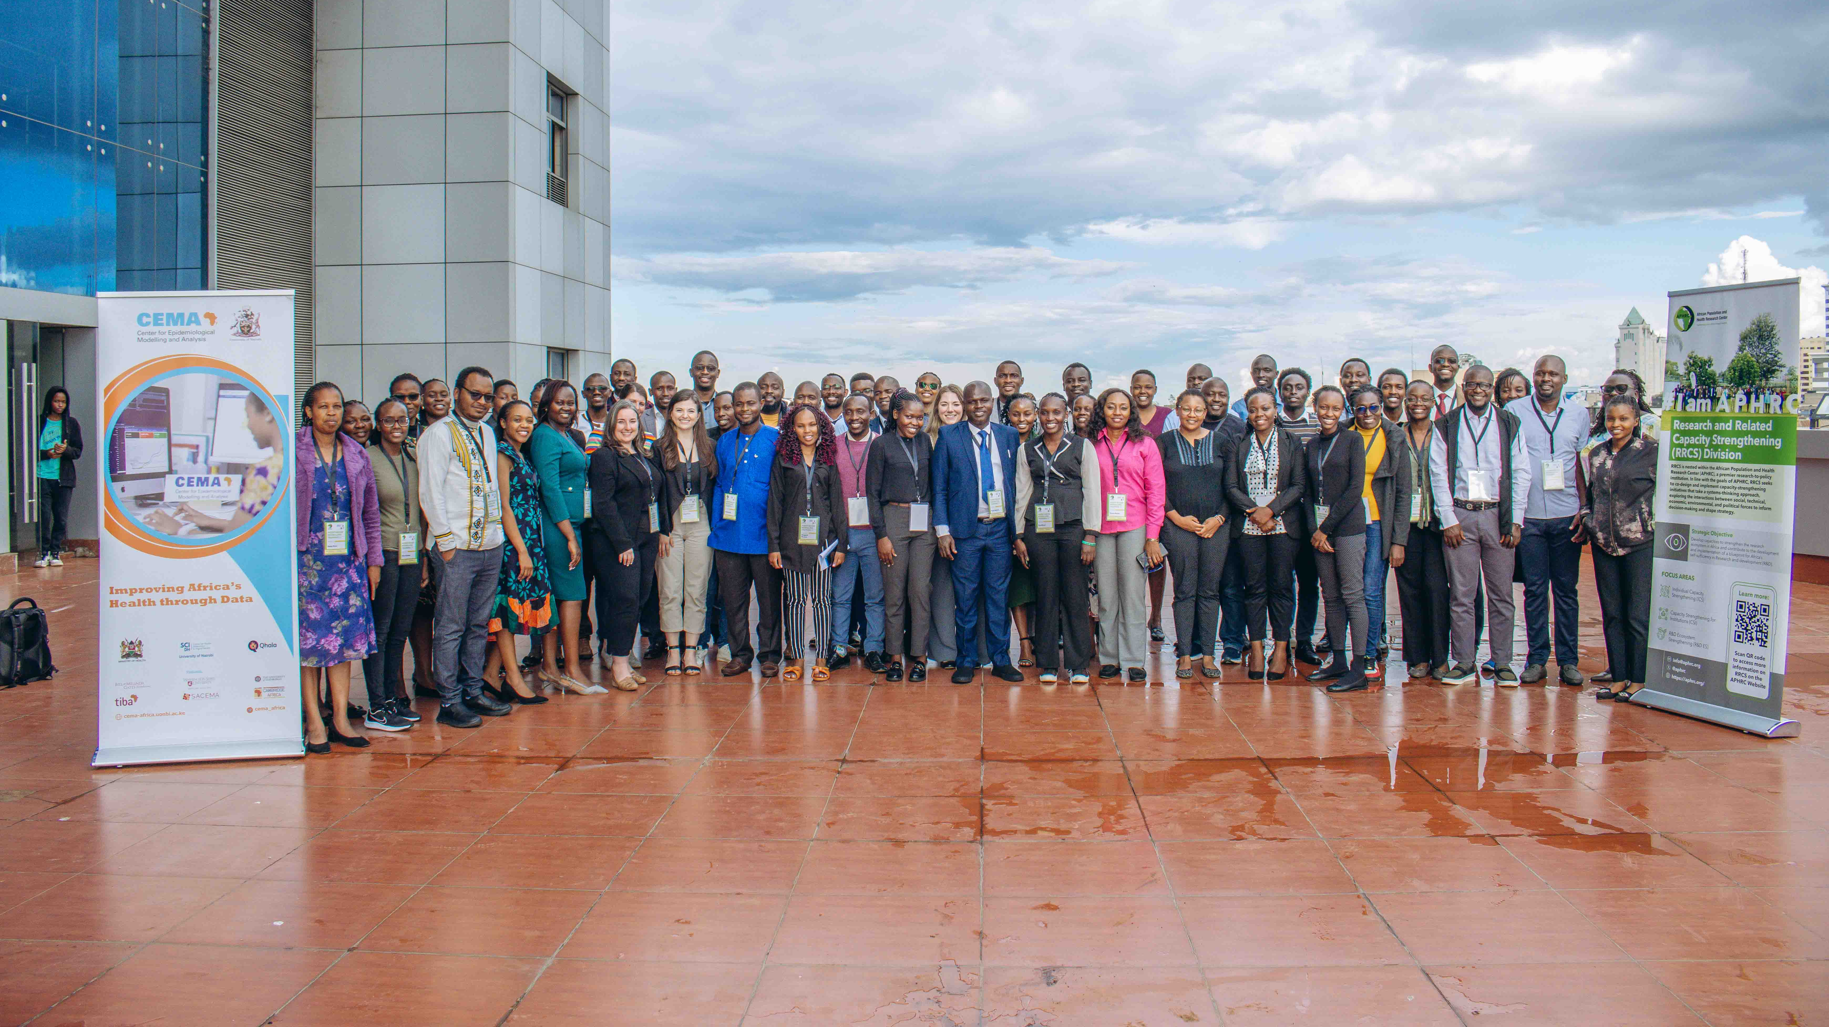
Acknowledgements

Slide 19

Time for Q and A

Slide 20
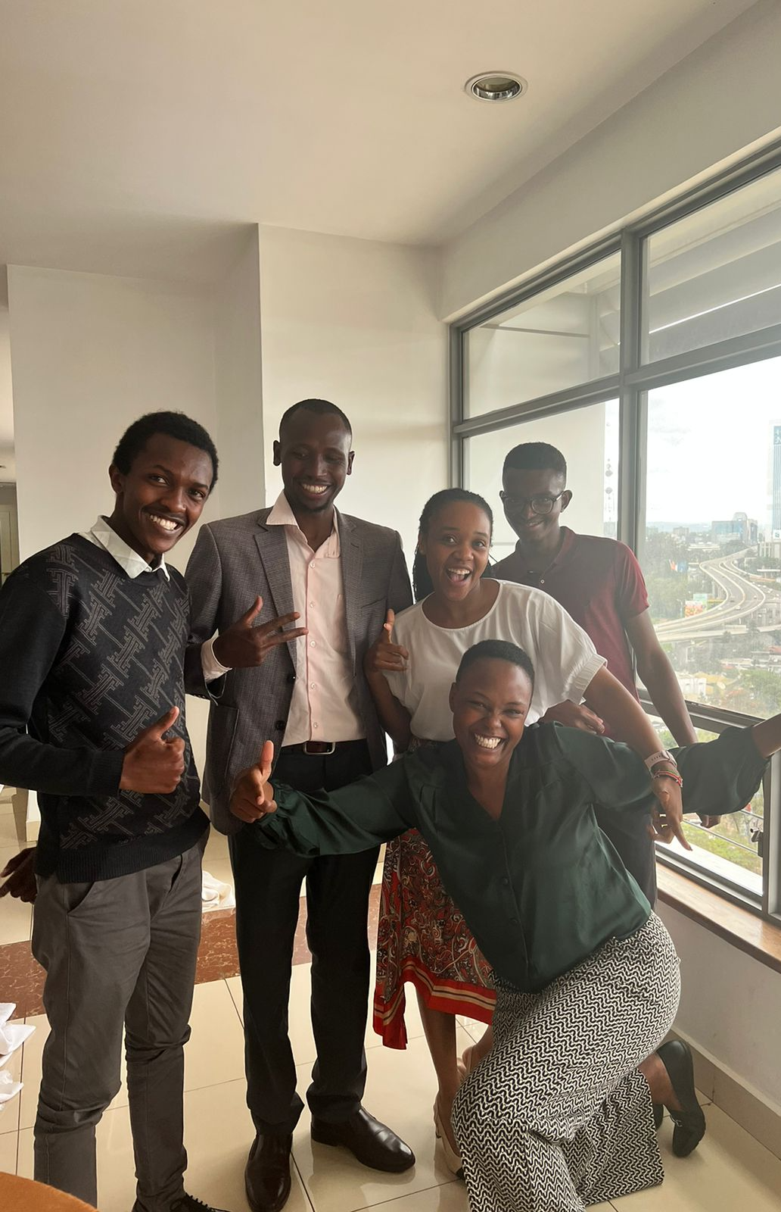
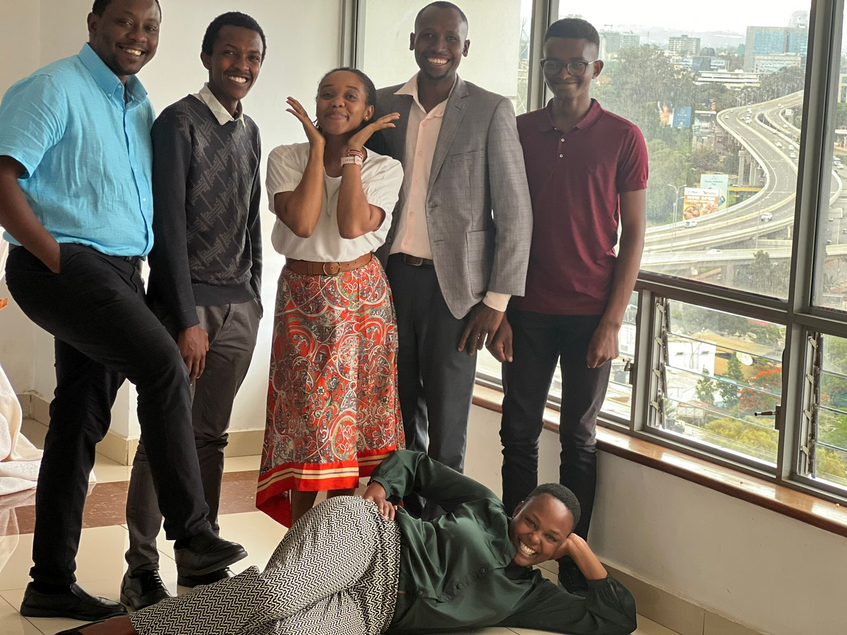

Thank you

